Slide 1

Terraform
B
Y
K
U
M
A
R
B
Y
K
U
M
A
R

Slide 2
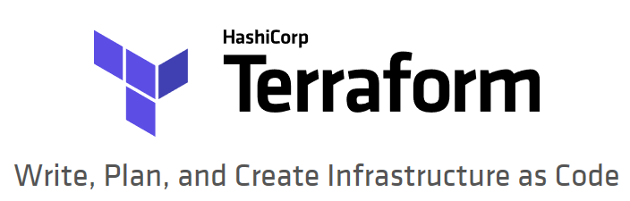
What is Terraform?
Terraform is a tool for building, changing, and versioning infrastructure safely and efficiently. Terraform can manage existing and popular service providers as well as custom in-house solutions.
Notes:
https://www.terraform.io/intro/index.html

Slide 3
The key features of Terraform
Infrastructure as a Code
Execution Plans
Resource Graph
Change Automation
Notes:
https://www.terraform.io/intro/index.html
Infrastructure as Code
Infrastructure is described using a high-level configuration syntax. This allows a blueprint of your datacenter to be versioned and treated as you would any other code. Additionally, infrastructure can be shared and re-used.
» Execution Plans
Terraform has a "planning" step where it generates an execution plan. The execution plan shows what Terraform will do when you call apply. This lets you avoid any surprises when Terraform manipulates infrastructure.
» Resource Graph
Terraform builds a graph of all your resources, and parallelizes the creation and modification of any non-dependent resources. Because of this, Terraform builds infrastructure as efficiently as possible, and operators get insight into dependencies in their infrastructure.
» Change Automation
Complex changesets can be applied to your infrastructure with minimal human interaction. With the previously mentioned execution plan and resource graph, you know exactly what Terraform will change and in what order, avoiding many possible human errors.

Slide 4
Why Terrafomr?
AWS and Terrafomr partnership https://aws.amazon.com/blogs/apn/terraform-beyond-the-basics-with-aws/
Terraform template define in declarative approach, immutable
Terraform maintain local/remote state
Terraform work in onprem or any cloud

Slide 5
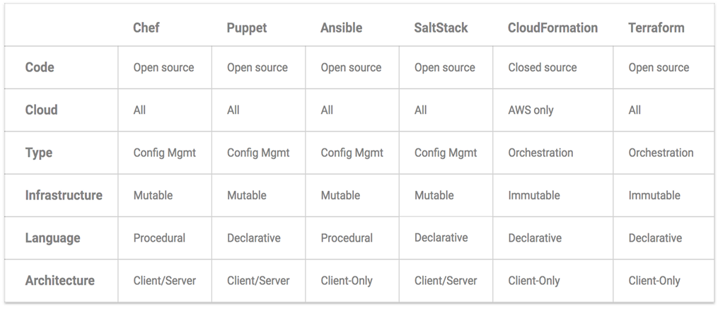
Terrafomr Vs Others
Notes:
https://blog.gruntwork.io/why-we-use-terraform-and-not-chef-puppet-ansible-saltstack-or-cloudformation-7989dad2865c

Slide 6
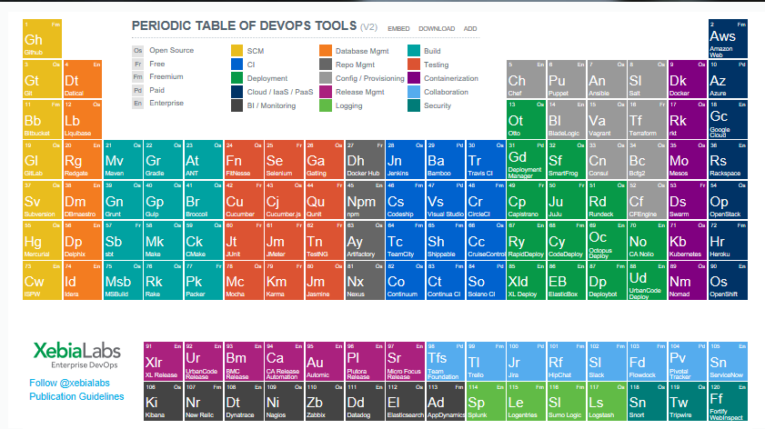
Terrafomr in XebiaLabs

Slide 7
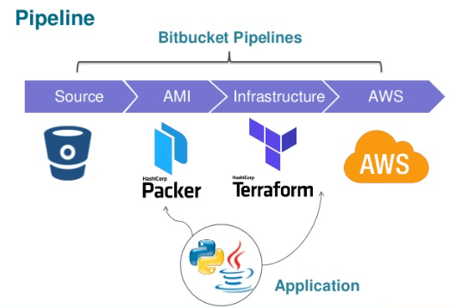
Terraform will paly vital roles for infra. provisioning

Slide 8
What we are going to learn?
Install of Terraform
Build Infrastructure
Change Infrastructure
Destroy Infrastructure
Resource Dependencies
Provision
Input Variables
Output Variables
Modules
Remote Backends
Programming Structure , Terraform syntax, internals, and patterns, Terraform Coding Examples

Slide 9
What we are going to learn?
Packer and Terraform together
Jenkins and Terraform integration
How to convert AWS Architecture to IaaC with example?
Note: All this will be done in AWS

Slide 10
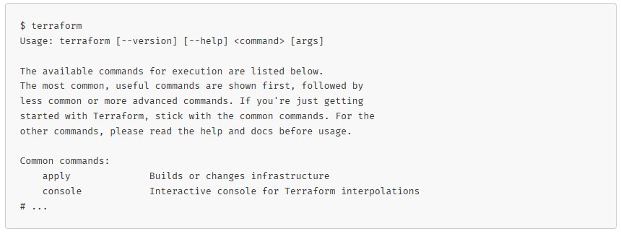
Verifying the Installation

Slide 11
Terraform Common commands
apply Builds or changes infrastructure
console Interactive console for Terraform interpolations
destroy Destroy Terraform-managed infrastructure
env Workspace management
fmt Rewrites config files to canonical format
get Download and install modules for the configuration
graph Create a visual graph of Terraform resources
import Import existing infrastructure into Terraform
init Initialize a Terraform working directory
output Read an output from a state file
plan Generate and show an execution plan

Slide 12
Terraform Common commands
providers Prints a tree of the providers used in the configuration
push Upload this Terraform module to Atlas to run
refresh Update local state file against real resources
show Inspect Terraform state or plan
taint Manually mark a resource for recreation
untaint Manually unmark a resource as tainted
validate Validates the Terraform files
version Prints the Terraform version
workspace Workspace management
All other commands:
debug Debug output management (experimental)
force-unlock Manually unlock the terraform state
state Advanced state management

Slide 13
example.tf
provider "aws" {
access_key = "AccessKeyPlaceHere"
secret_key = "SecretKeyPlaceHere"
region = "eu-central-1"
}
resource "aws_instance" "example" {
ami = "ami-e28d098d" #replace your own ami from aws console
instance_type = "t2.micro" #type of instance
security_groups = [ "sg-bbab26d1" ] #security grou
subnet_id = "subnet-1cad5b77" #subnet id extracted form aws console
tags {
Name = "Kuamr" #tag name
Function = "Terraform Testing" #tag name
Purpose = "Terraform Testing" #tag name
}
}

Slide 14
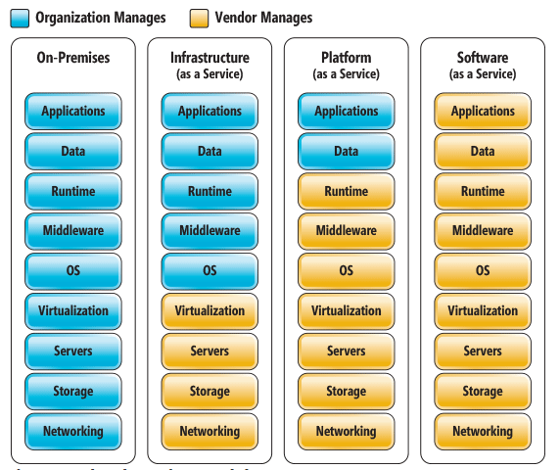
On-premises vs Cloud

Slide 15
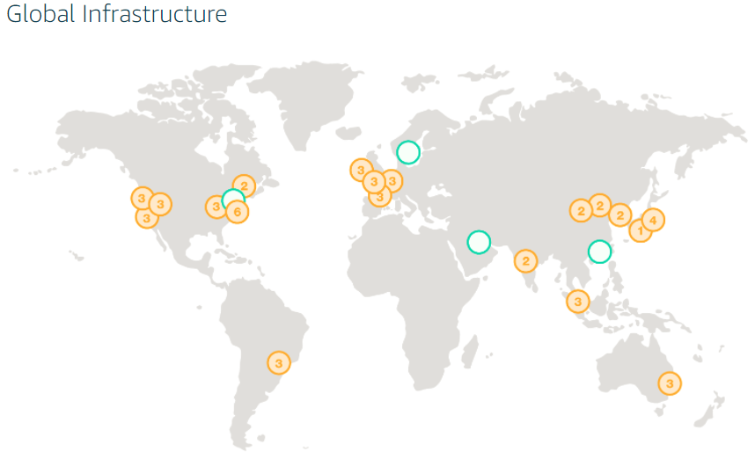
AWS, region & Az’s
The AWS Cloud spans 54 Availability Zones within 18 geographic Regions and 1 Local Region around the world, with announced plans for 12 more Availability Zones and four more Regions in Bahrain, Hong Kong SAR, Sweden, and a second AWS GovCloud Region in the US.

Slide 16
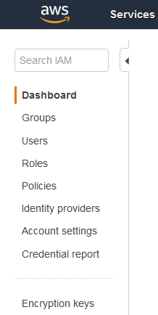
AWS, region & Az’s
Notes:
IAM
Access key
Secret key

Slide 17
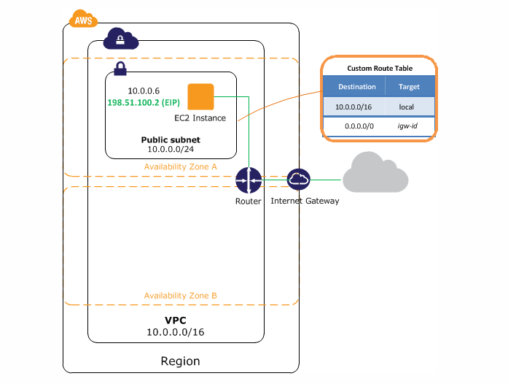
AWS, AWS VPC
Notes:
VPC

Slide 18
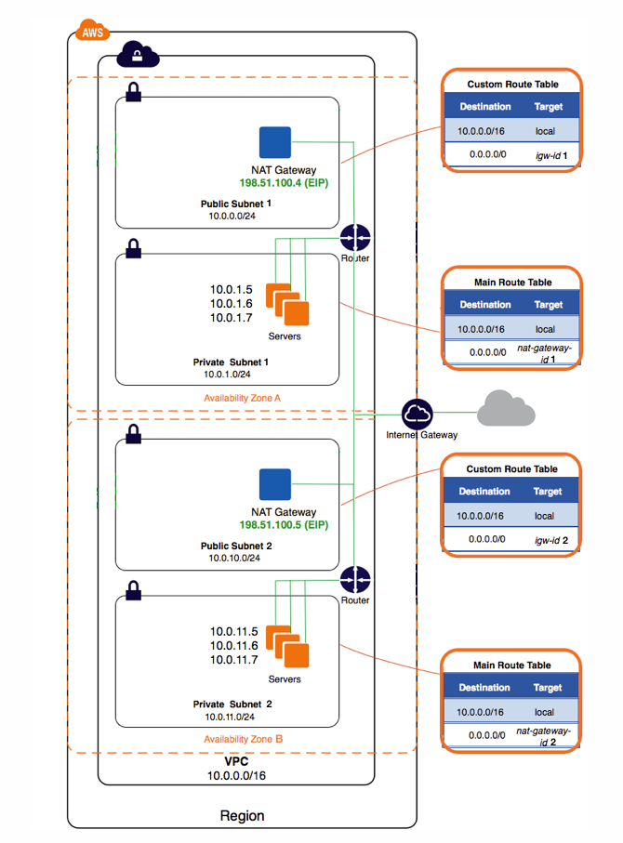
AWS, VPC with HA
Notes:
VPC
With high avaibility

Slide 19
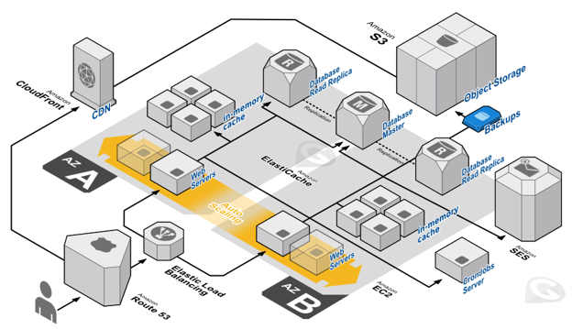
AWS AZ’s

Slide 20
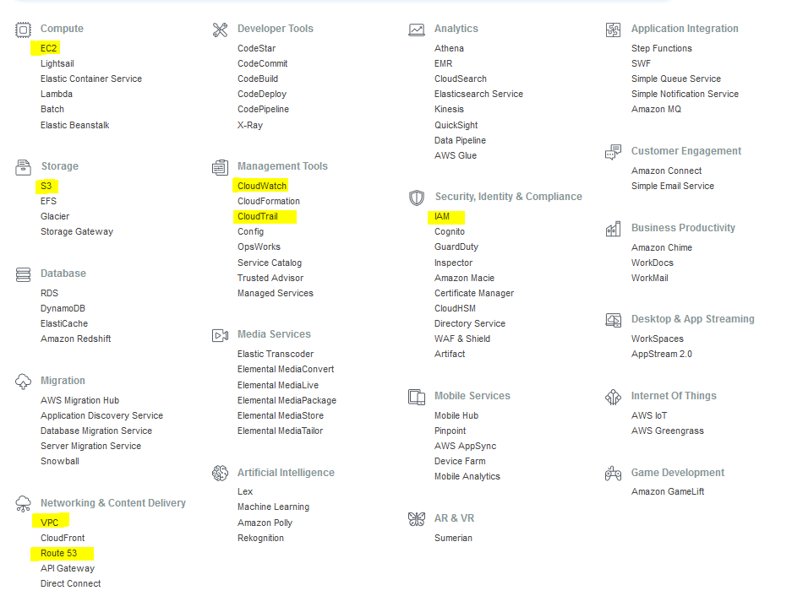
AWS Services

Slide 21
AWS, VPC with HA
www.a2info.com
IE
Notes:
VPC
With high avaibility

Slide 22
Conclusions
End of this course you will able to understand
HCL
Infrastructure as a Code for AWS
How to convert AWS Architecture to Code
Jenkins integration with Terraform as pipeline
Twice of your current salary
Notes:
Demo

